Slide 1

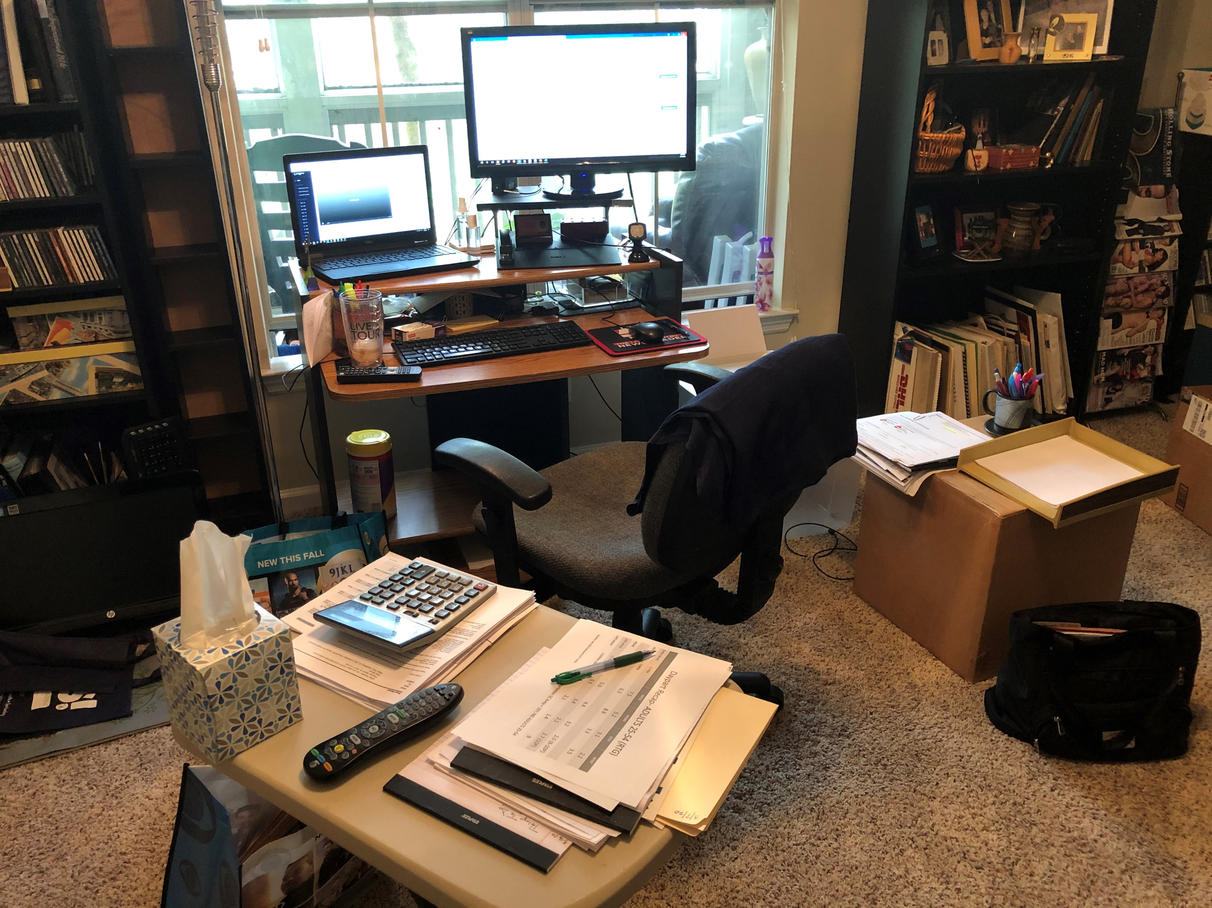
WCSC- Charleston SC Brad Wood National Sales Manager

